Slide 1
GCC compiler
Linux

Slide 2
Introduction to GCC Compiler: Basics and Usage
GCC is a powerful and widely used compiler that supports multiple programming languages, including C, C++, and Fortran. In this presentation, we'll cover the basics of GCC, including the compilation and execution of a program, as well as discussing time stamping

Slide 3
Basics of GCC
GCC provides a suite of compilers for different programming languages.
Command-line tool; can be accessed through the terminal.
Primary components include: Preprocessor, Compiler, Assembler, Linker.

Slide 4
Compilation of Program
Compilation is the process of translating your high-level source code into low-level machine code that the computer can understand and execute. To compile a program using GCC, you use the ‘gcc’ command followed by the source code file's name and any necessary flags.
1. Preprocessing:
Removes comments.
Expands macros.
Includes header files.
2. Compilation:
Transforms source code into assembly code.
Checks for syntax and semantic errors.

Slide 5
3. Assembly:
Converts assembly code to machine code.
4. Linking:
Combines multiple object files and libraries into an executable.
Resolves references between files.

Slide 6
Execution of Program
After successful compilation, the program can be executed.
In the terminal, run the generated executable file.
Example command: ./a.out (for the default output file named "a.out").

Slide 7
Time Stamping
GCC provides time stamping information for tracking file changes.
Useful for determining if a source file has been modified since the last compilation.
Command: gcc -E -M -MT <output_target> <source_file>

Slide 8
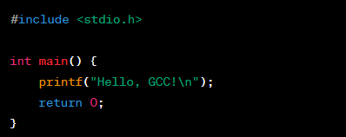
Example - Compilation
Source Code (example.c):

Slide 9
Terminal Commands:
Preprocessing: gcc -E example.c -o example.i
Compilation: gcc -S example.i -o example.s
Assembly: gcc -c example.s -o example.o
Linking: gcc example.o -o hello

Slide 10
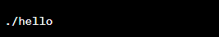
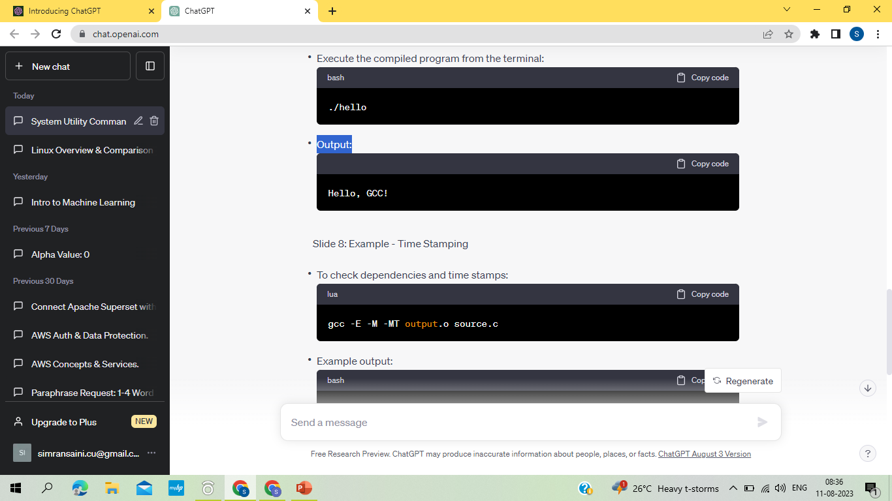
Example - Execution
Execute the compiled program from the terminal:
Output:

Slide 11
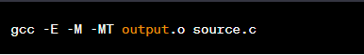
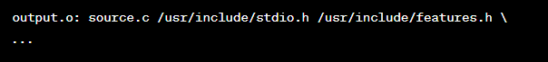
Example - Time Stamping
To check dependencies and time stamps:
Example output:

Slide 12
Advantages of GCC
Open-source and actively maintained.
Cross-platform compatibility.
Supports various optimization levels.
Wide language support.
Well-established in the programming community.

Slide 13
Conclusion
GCC is a powerful and versatile compiler used for compiling programs written in multiple languages.
Understanding the basics of GCC, the compilation process, execution, and time stamping is essential for efficient programming and development.

